Slide 1
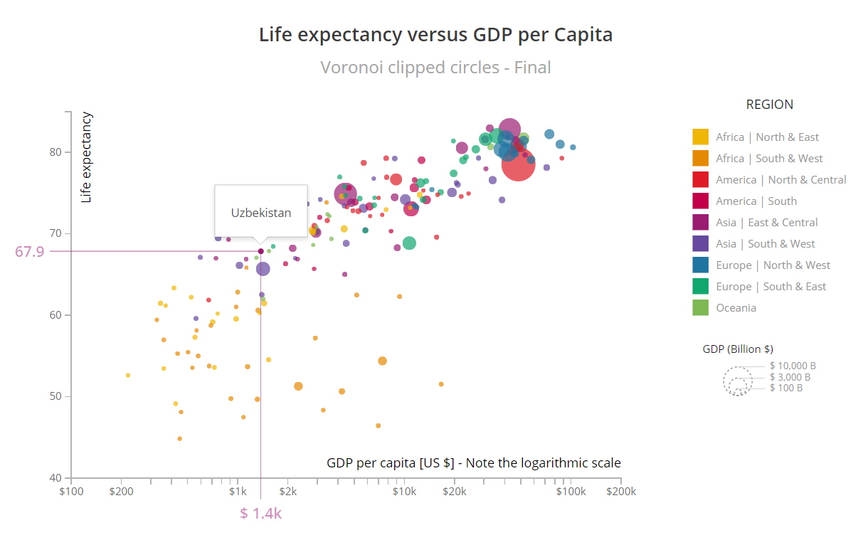
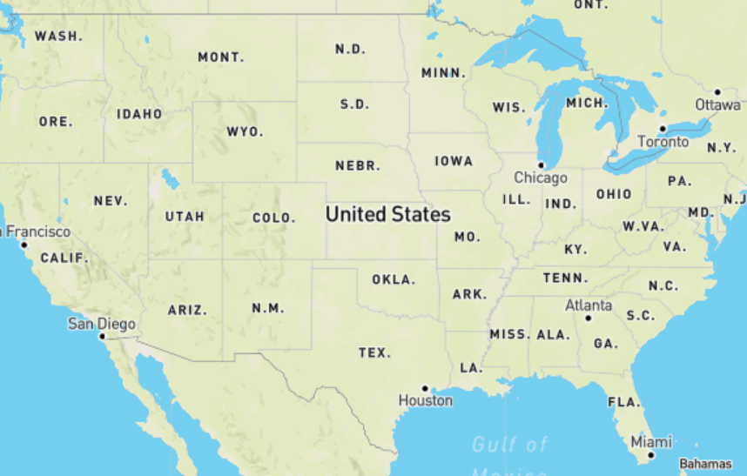
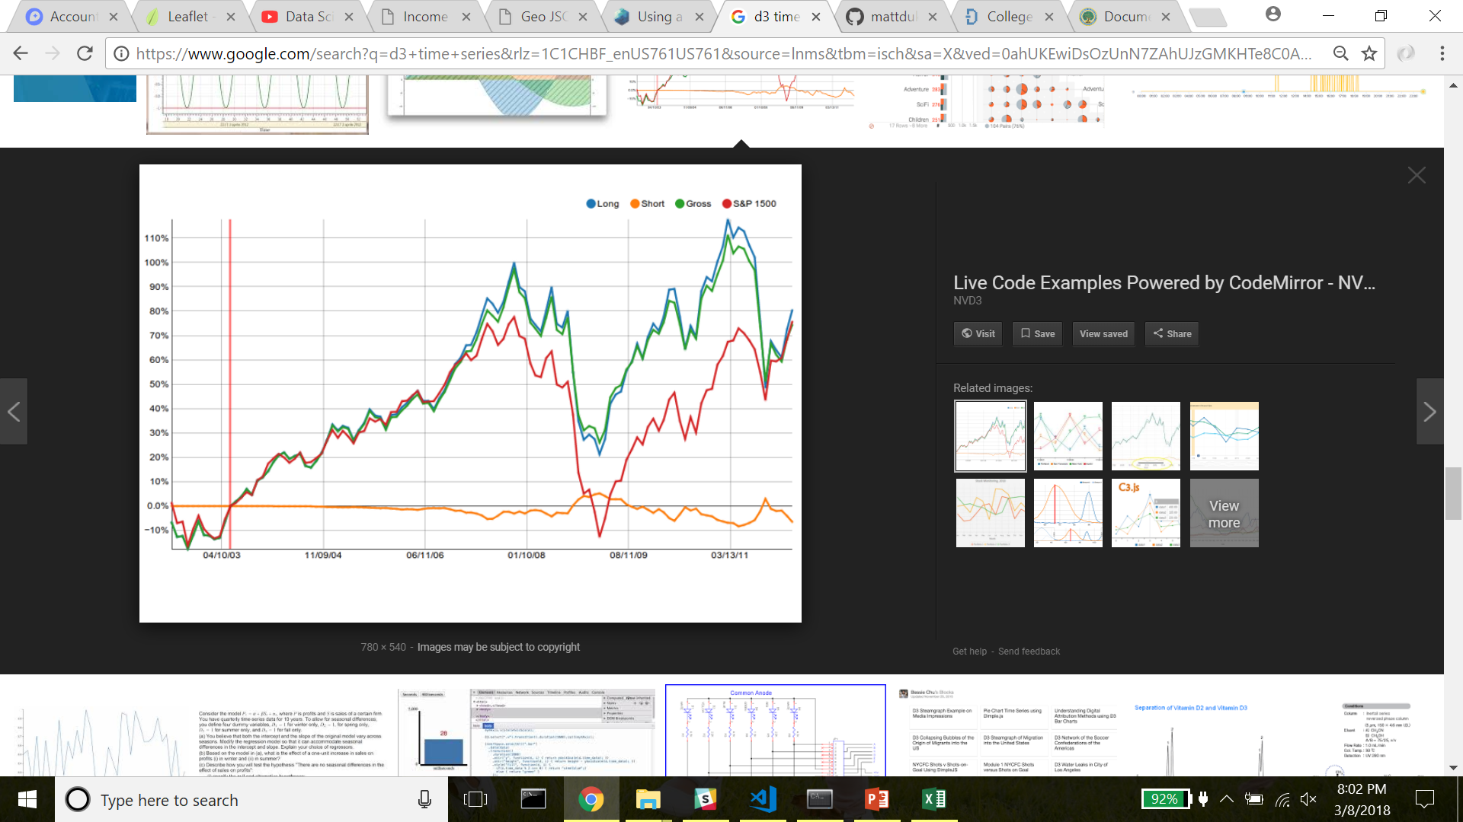
University Scorecard
Bubble chart has slider to narrow universities based on features (i.e. SAT Avg.). Bubble updates when cursor over legend.
Map has markers for universities. Map zooms in on campus when selected on Bubble Chart.
Time series chart shows % change over time for SAT Avg, Admission Rate, Tuition Cost when university is clicked on in Bubble Chart

